Slide 1
Big Bang ASQ Project
Team Member
Neeru Bansal - Project Manager
Jaime - Software Architect
Harry - Software Developer
Nikitha - Software Tester

Slide 2
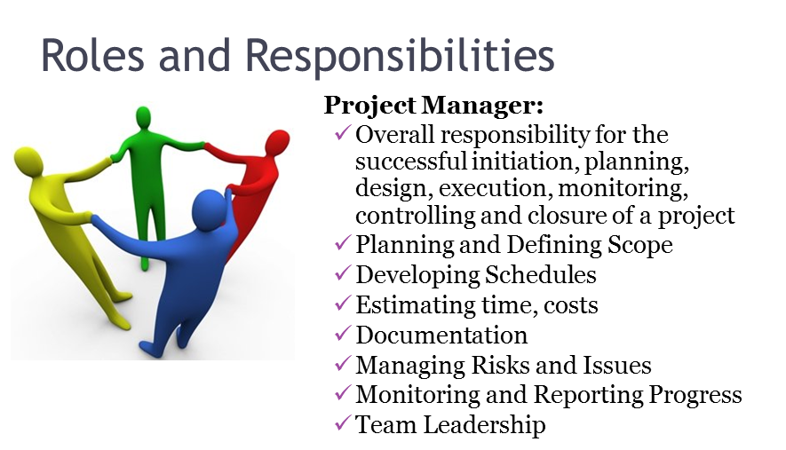
dfsdf

